Slide 1
Welcome to
LetsQuiz (LQ)
From: YeetCode
That’s us :D

Slide 2



Have you ever heard of little something called Quizlet?
How about Anki?
Or just the basic flashcard app?
Bet you’ve never heard of them

Slide 3

WELL THIS IS NOTHING LIKE THAT
Lets Quiz is a completely original idea that has nothing to do with any known flashcard application out there
LETS QUIZ
QuizLets
Page #

Slide 4


LETS QUIZ
Look at how much fun we’re having!!!
Our completely original idea is to create a flashcard application where you can create, edit, and delete your cards. In order to use our completely free source application you must make a fun free account (though if you would like to pay we I guess we wouldn't say no…). Study using the best and most original app out there!
This is definitely us working!!!

Slide 5
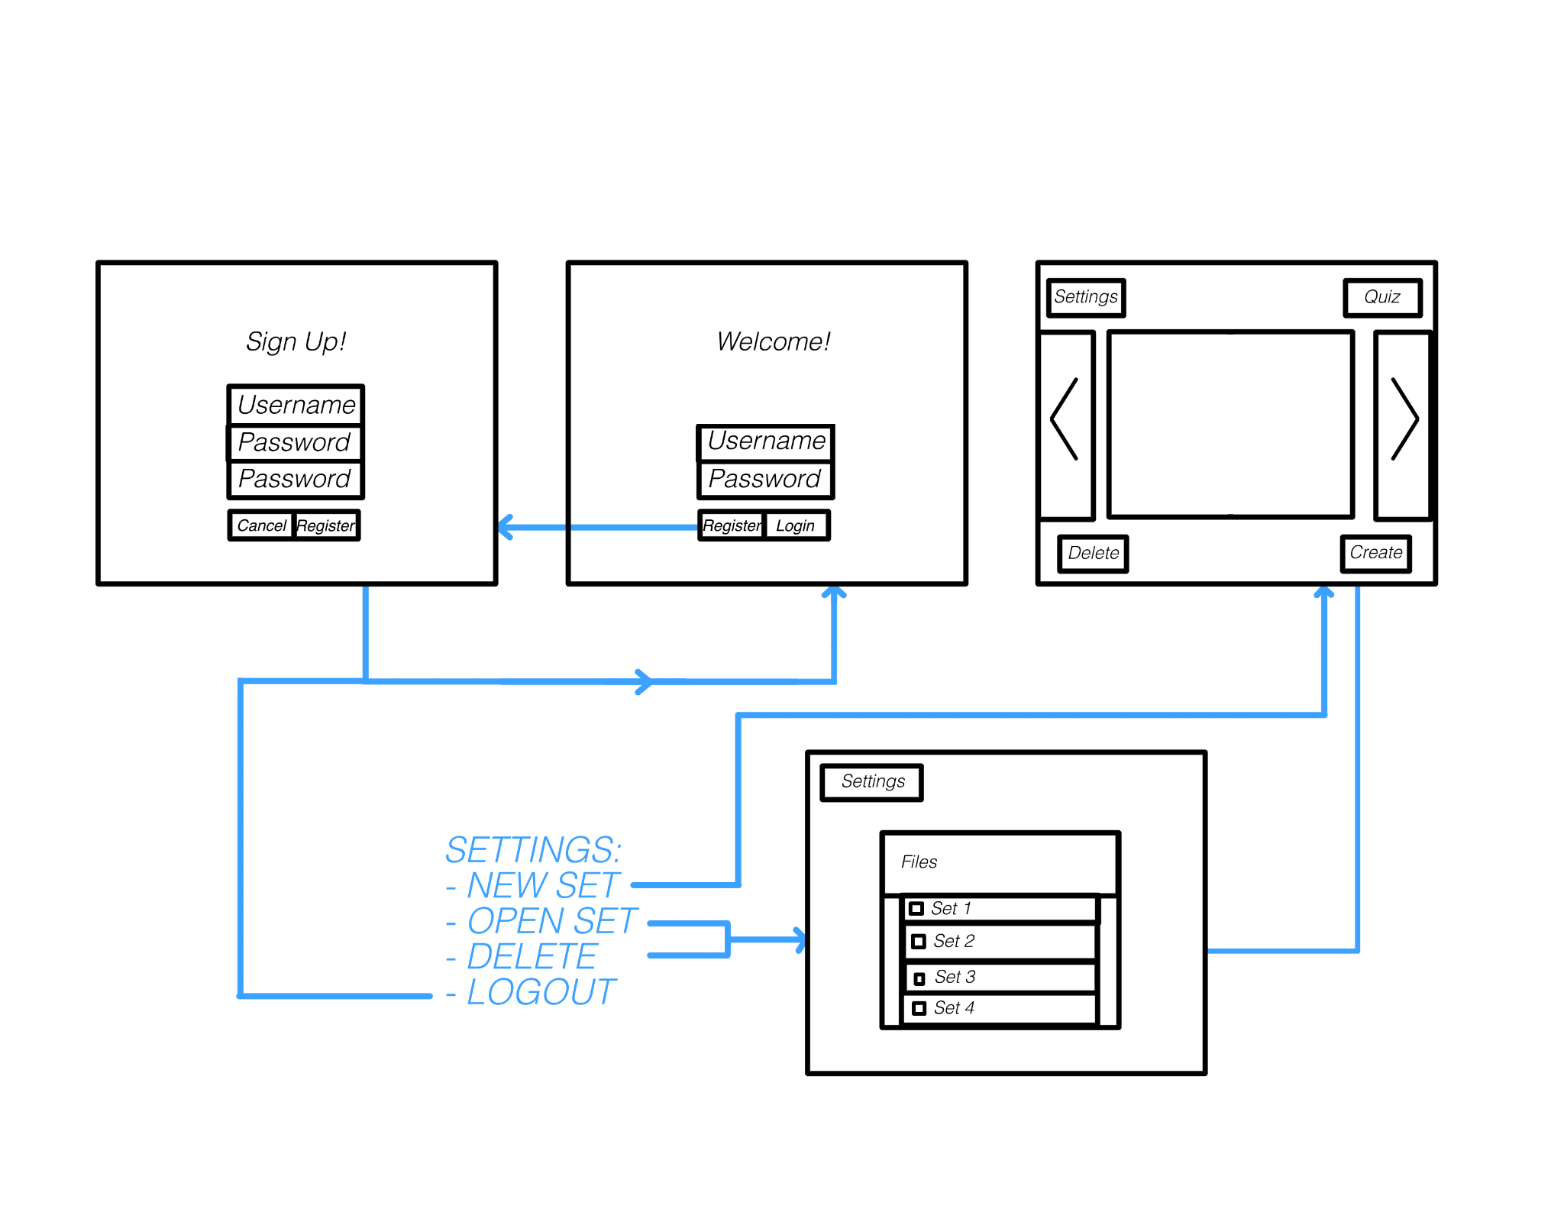
1.
2.
3.
4.
Sign-up page used to create your profile in order to sign in
Welcome page so you can log in to our beautiful application
Lets give you a better understanding of
Editing page where you create and edit your flashcards
Flashcard page where you can review all the flashcards you have made
The Game Plan
Howdy Howdy Howdy Howdy Howdy Howdy Howdy Howdy Howdy Howdy Howdy Howdy Howdy Howdy Howdy Howdy Howdy Howdy Howdy Howdy Howdy Howdy Howdy Howdy Howdy Howdy

Slide 6
Goals
Outcomes
Making A Working Product
Were we able to complete our goals and make a fully-functional product in under 24 hours?
We made a working application!!!
Include Some Security Aspect
We created a security element to it!!!
Were we capable to implementing some type of cyber security into our functioning application?
Implementing Docker
Sadly we were close
AND WE MADE IT
Were we able to learn a new application and use it to help build our app all in under 24 hours?
Well we clearly made the best app of all time we were more happy we were able to put complete this challenge with a nice working product
Make the perfect app
Did we make the most perfect application the world has ever seen?
Team Name
If your looking down here don’t worry there's only 1 more page left

Slide 7
Main Points
Planned ideas
Scraped Ideas
Self-contained app
Authentication System
Create and manipulate flashcards
Create an open source alternative
Ingame Rewards
Notifications
Level-up system
Pantry app
Videogame
AI-implementation
Quiz Me!
Data Base
More security
User Account options
Working on everything we did not get to on this list and more!
Fun ideas
Scope
Moving forward
Team Name
Page #

Slide 8
Thank you!!!
Quizlet plz don’t sue

